Slide 1
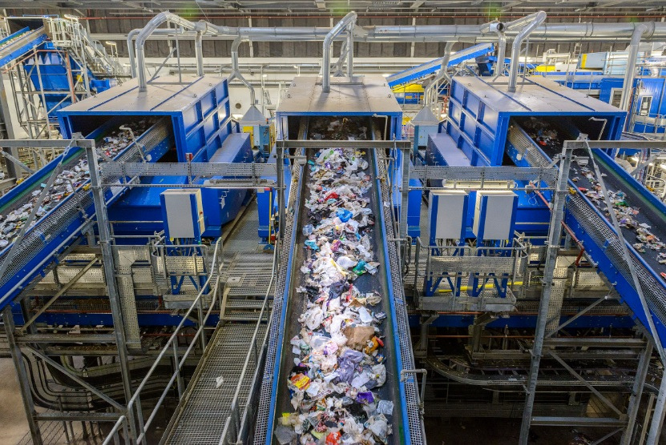
August 2026
VISION-LANGUAGE-ACTION MODELS FOR TRANSPARENT PLASTIC WASTE SORTING
Méa Vittot
MSc Robotics
Heriot-Watt University
Supervisor: Dr. Maria Koskinopoulou
From roboticsbiz.com

Slide 2
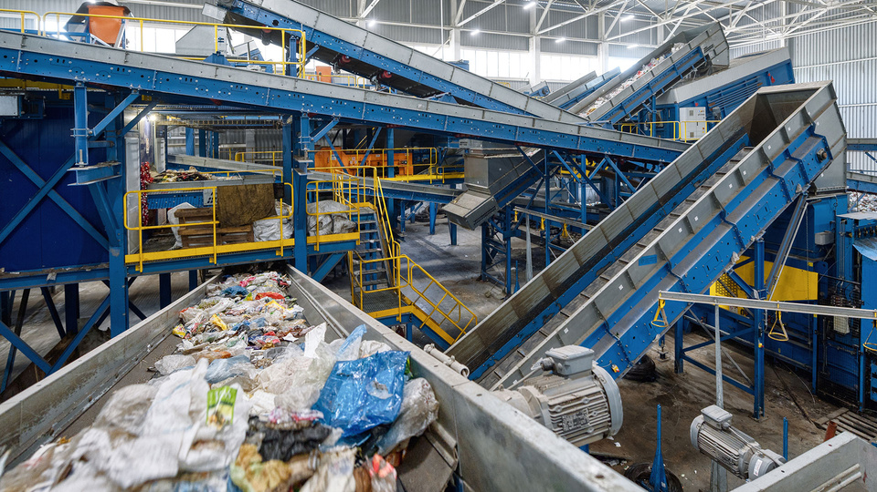
Fauget I 02
THE PROBLEM
Transparent plastics break depth sensors; no robot demonstration data exists for this domain.
From www.boschrexroth.com
The sensor sees nothing.
Notes:
Less than 10% of plastic is recycled. Robotic sorting could help,
but it has a blind spot. These are transparent PET bottles — the
single most common recyclable plastic. On the left, what the camera
sees. On the right, what the depth sensor sees. Black means zero —
the sensor returns nothing. The structured infrared light refracts
straight through the plastic. The robot doesn't know the object
exists in 3D space.
[Pause ]
"Every robotic manipulation pipeline I know of assumes functioning
depth. So how do you grasp something the sensor can't see?"

Slide 3
STATE OF THE ART
Fauget I 03

Slide 4
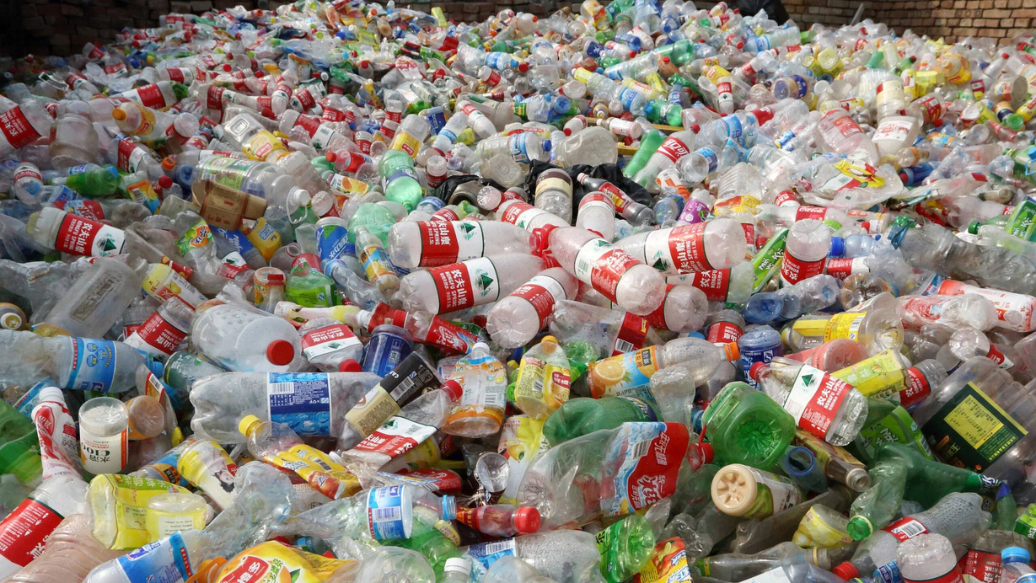
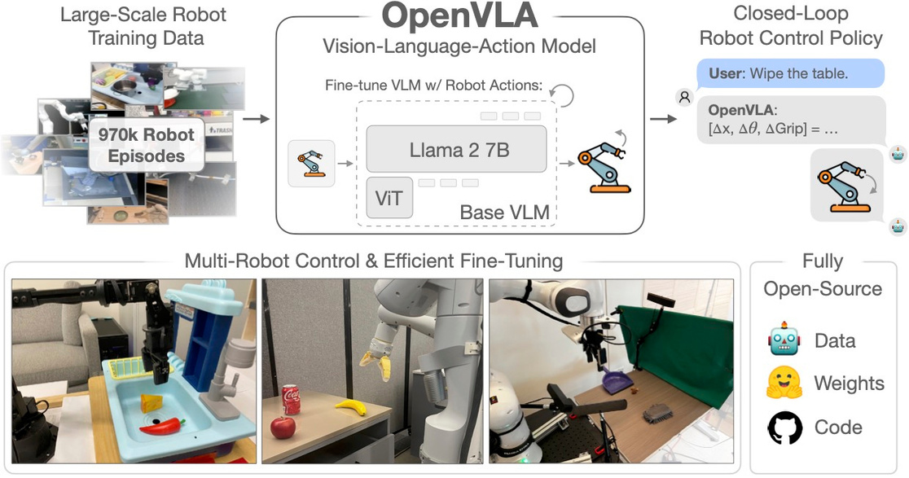
Fauget I 03
WHY A VLA? WHY LANGUAGE?
Waste sorting needs semantic flexibility
A VLA can interact with a person not just match templates
from openvla.github.io
Notes:
Classical sorting uses fixed rules per plastic type. A new yogurt
pot design means retraining from scratch. Vision-Language-Action
models offer something different — you can tell them what to do in
natural language. 'Pick up the clear bottle.' 'Sort the recyclable
items.' The model draws on internet-scale knowledge to recognise
objects it's never been trained on.
But — no one has tried this on transparent waste, and there's no
robot demonstration dataset to train on. That's what this project
investigates.

Slide 5
Fauget I 03
STATE OF THE ART

Slide 6
Fauget I 06
AIM & RESEARCH QUESTIONS
Can composited synthetic data teach a VLA to spatially ground transparent objects?
1
How well does RGB-only perception recover transparent geometry, and generalise?
2
Does normal-guided depth reconstruction beat geometry-unaware inpainting?
3
A cascaded pipeline for language-conditioned grasp targeting on transparent waste, trained entirely on synthetic data
Is the pipeline feasible for conveyor deployment; what bounds throughput?
4

Slide 7
objectives

Slide 8
METHODOLOGY

Slide 9
Fauget I 04
THE PIPELINE
Notes:
The camera feeds two parallel paths. The RGB image goes to a
perception network that predicts surface normals and a segmentation
mask — essentially, where is the transparent object and what shape
is its surface. Those predictions feed a depth solver that fills
in the missing depth measurements.
Simultaneously, the same RGB image goes to OpenVLA — a 7-billion
parameter model fine-tuned with LoRA — which reads a language
instruction and outputs a 2D grasp target as discrete tokens.
The coordinate bridge combines the 2D target with the repaired
depth to get a 3D position in millimetres.
Everything in green is conceptual — I didn't have robot access.
The evaluation is on the blue and orange paths.

Slide 10
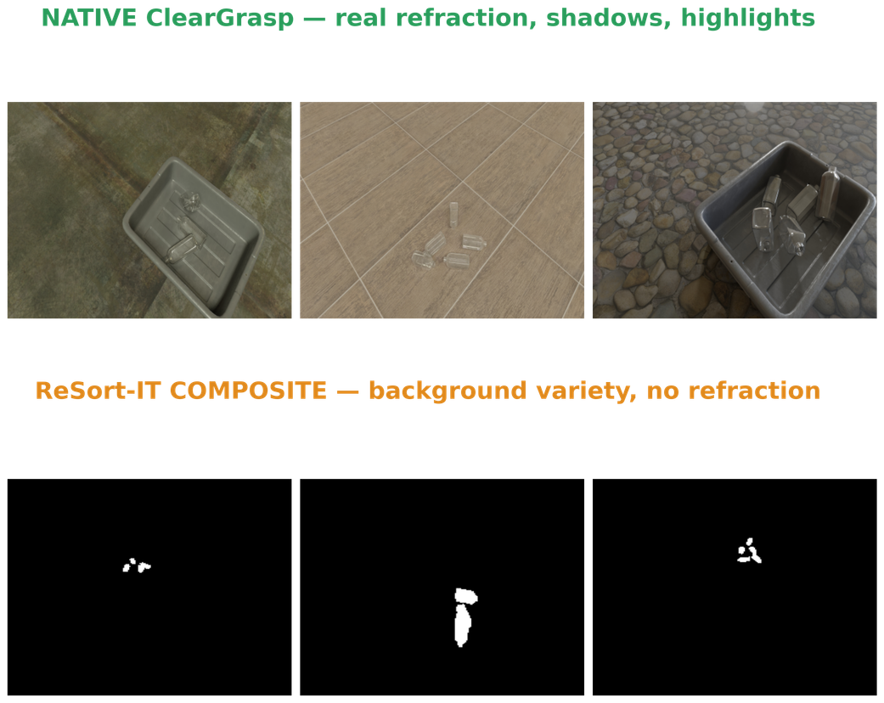
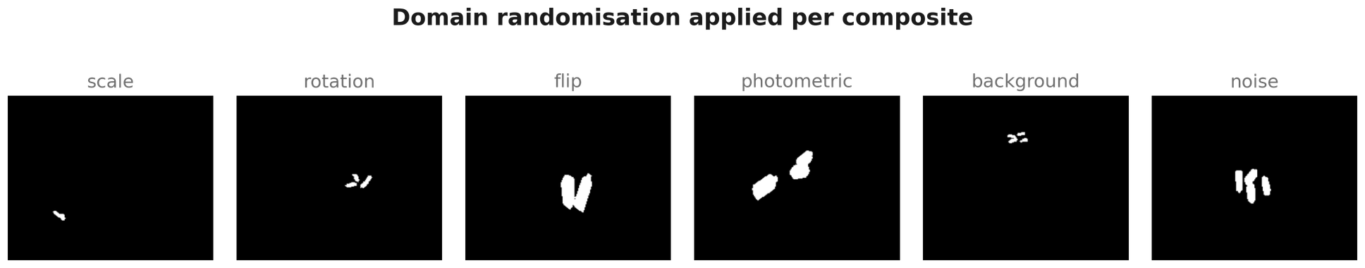
Fauget I 02
THE DATASET: RESORT-IT + CLEARGRASP

Slide 11
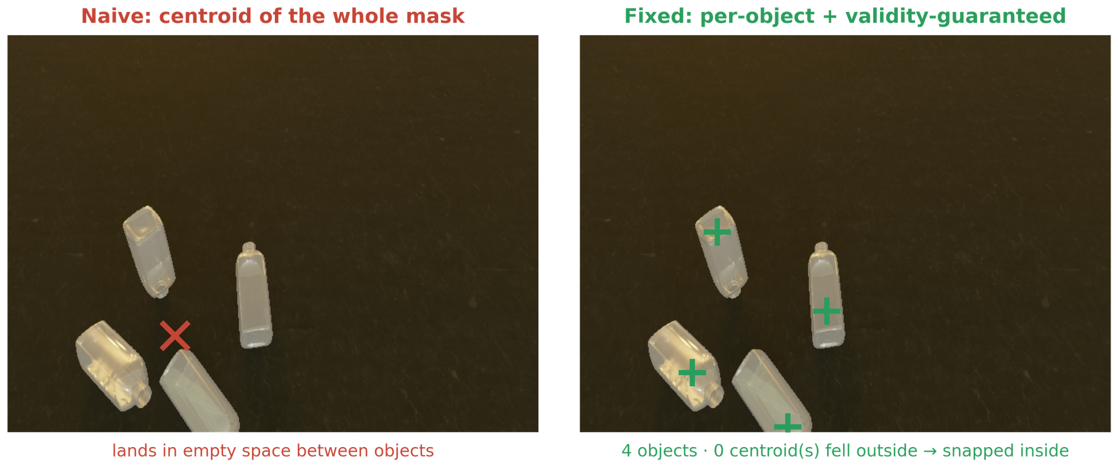
Fauget I 07
GRASP TARGET DERIVATION

Slide 12
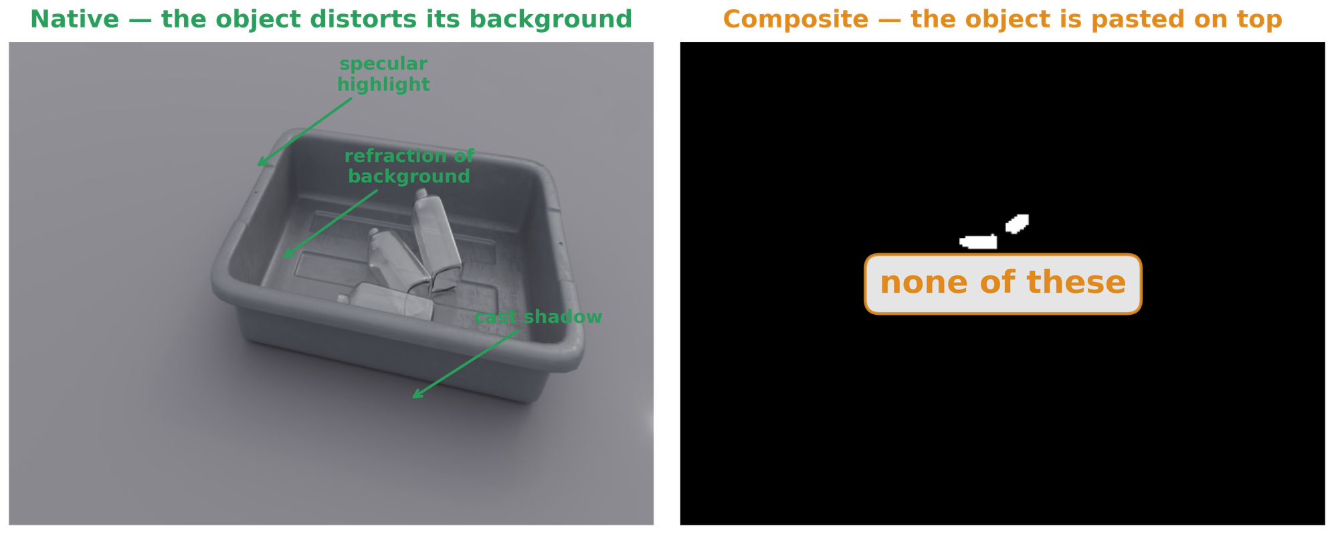
Fauget I 05
THE DATA PROBLEM

Slide 13
Fauget I 06
PERCEPTION MODULE

Slide 14
Fauget I 05
DEPTH RECONSTRUCTION SOLVER
Depth Reconstruction Sensitivity to Anchor Weight
Chosen (λ=100)
0.5
0.4
Mean RMSE (metres)
0.3
0.2
0.1
101
102
λ_anchor (log scale)
103

Slide 15
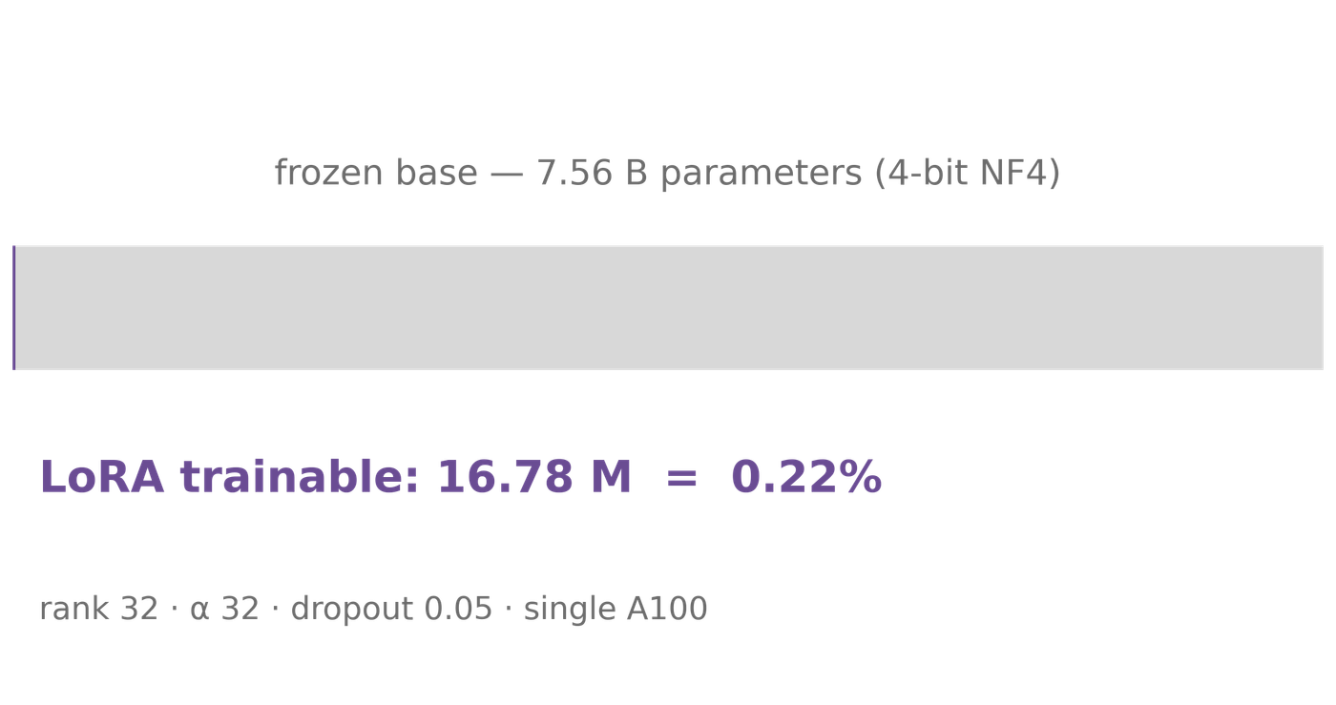
Fauget I 07
VLA FINE-TUNING + COMPUTE BUDGET

Slide 16
Item | Value
Base model | OpenVLA-7B (SigLIP + DINOv2 + Llama-2 7B)
Adaptation | LoRA, rank 32, α 32, dropout 0.05
Trainable params | 16.78 M = 0.22% of 7.56 B
Quantisation | 4-bit NF4 weights, bf16 compute
Hardware | 1× NVIDIA A100
Optimiser | AdamW, LR 1e-5, batch size 2
Training length | halted step 21,500 (mid-epoch 2), best val loss 0.154
Wall-clock | [fill from cluster logs — GPU-hours]
Action tokens | 256-bin uniform; 1 bin ≈ 0.875 px at 224²
VLA FINE-TUNING + COMPUTE BUDGET

Slide 17
RESULTS

Slide 18

Fauget I 03
THE MEMORISATION PROBLEM
??

Slide 19
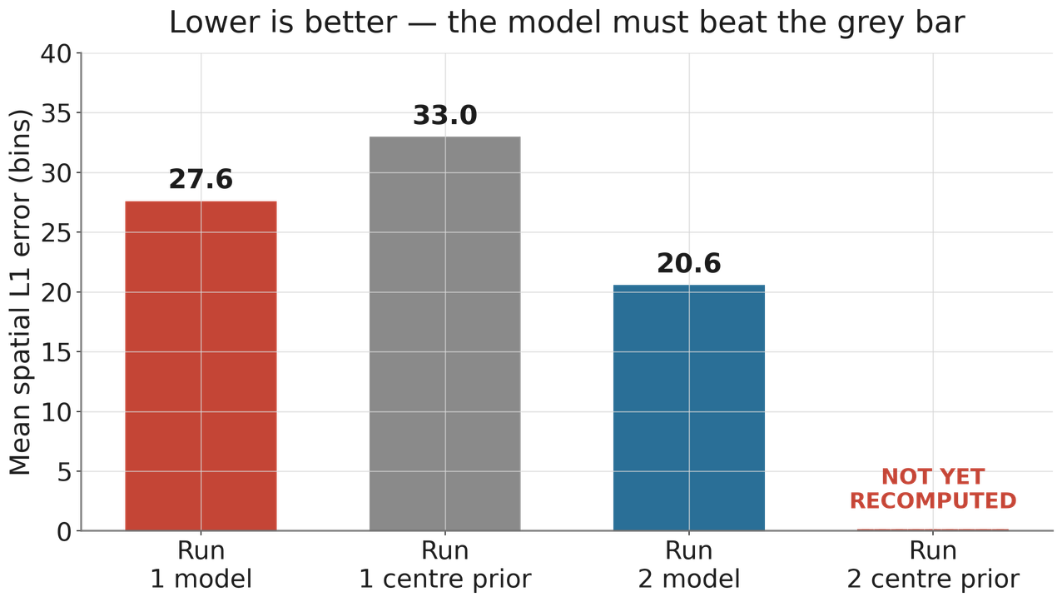
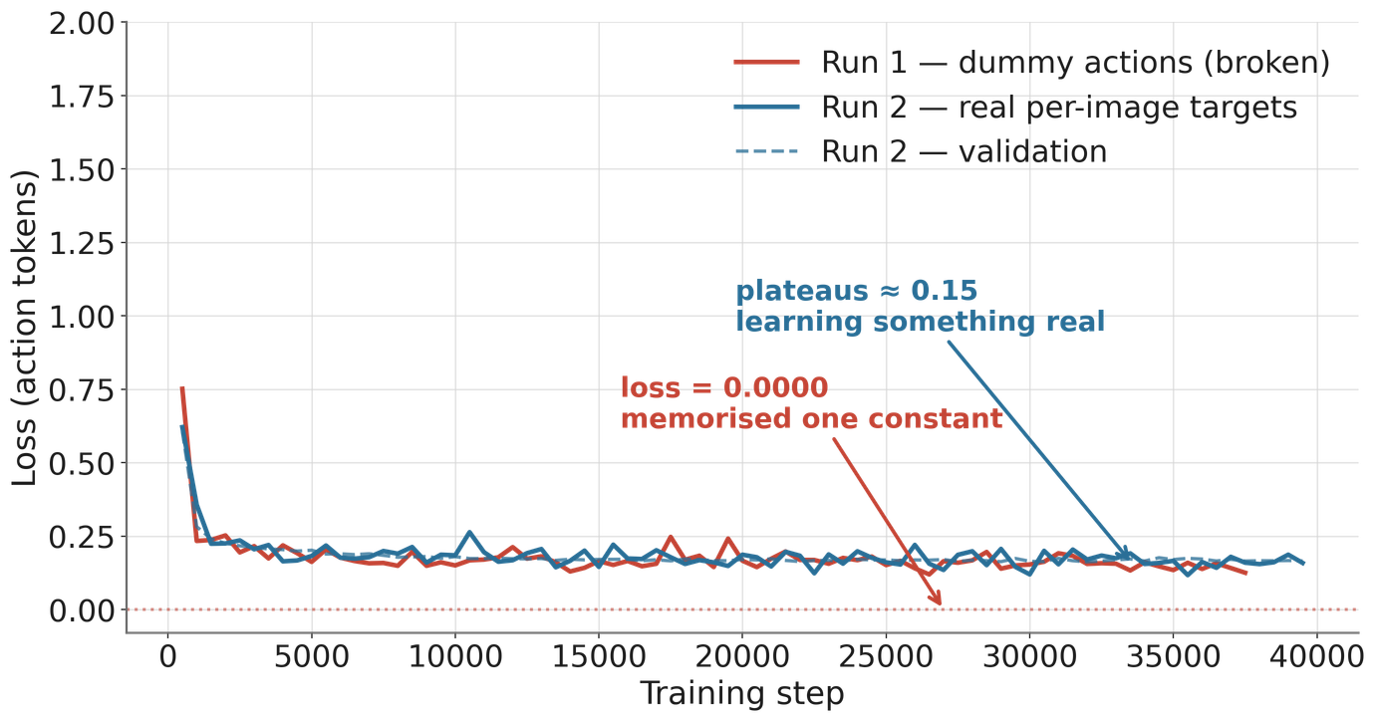
THE FIX, AND THE SECOND PROBLEM

Slide 20
Spatial error across checkpoints
Per-axis coordinate error
80
70
60
Mean Median
X error Y error
400 350 300 250
50
40
30
20
Spatial L1 error (bins)
Per-axis L1 error (bins)
200 150 100 50 0
0
5000
10000
15000
20000
25000
30000
35000
40000
0
5000
10000
15000
20000
25000
30000
35000
40000
Training step
Training step

Slide 21
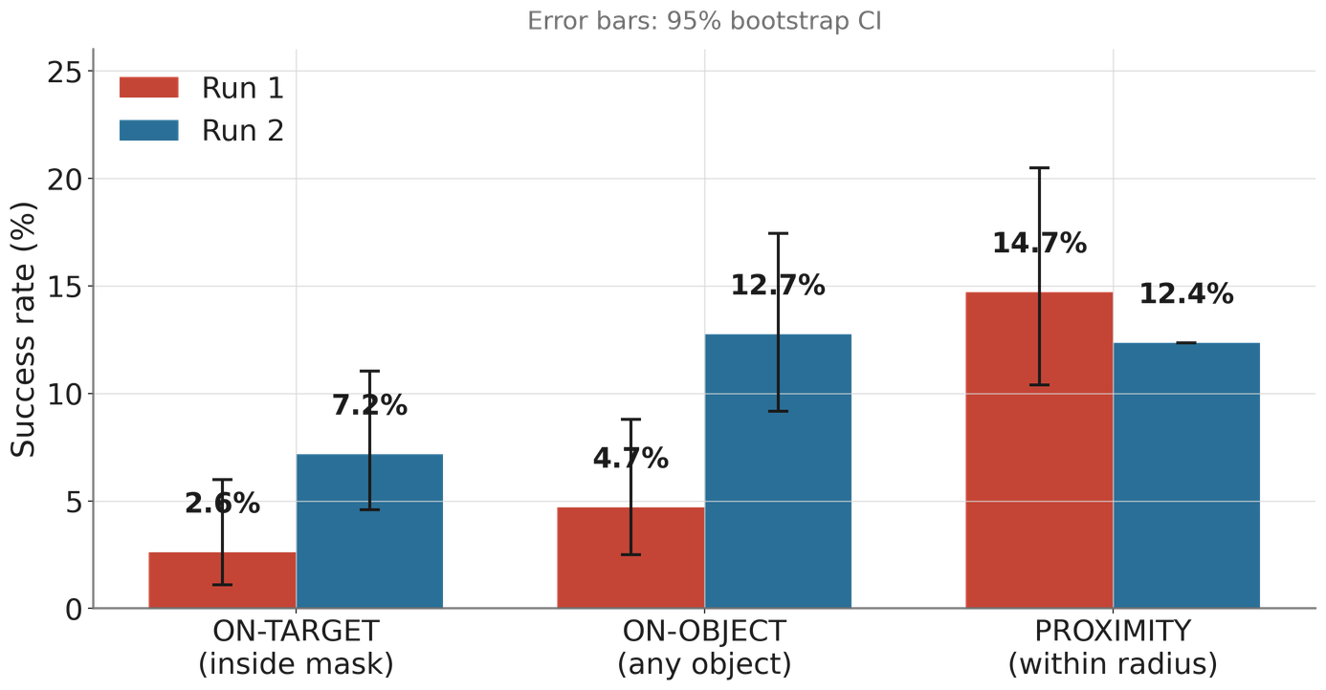
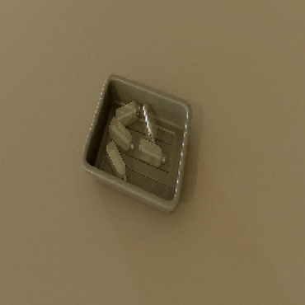
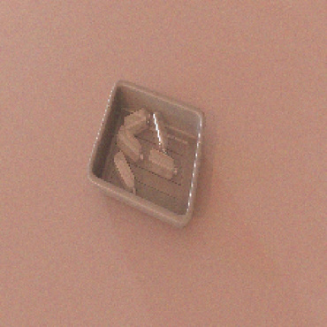
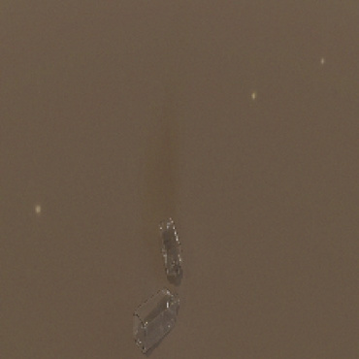
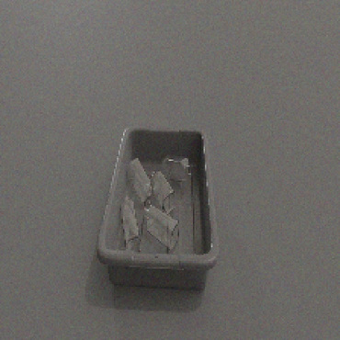
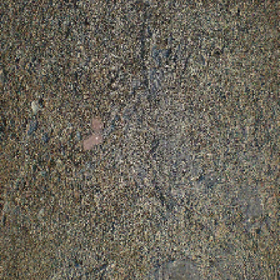
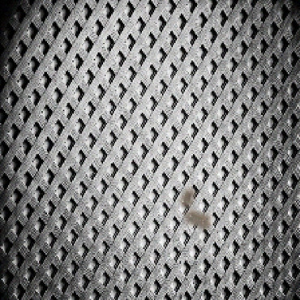
Fauget I 08
GRASP SUCCESS
TARGET HIT
TARGET HIT
OTHER OBJECT
OTHER OBJECT
MISS
MISS

Slide 22
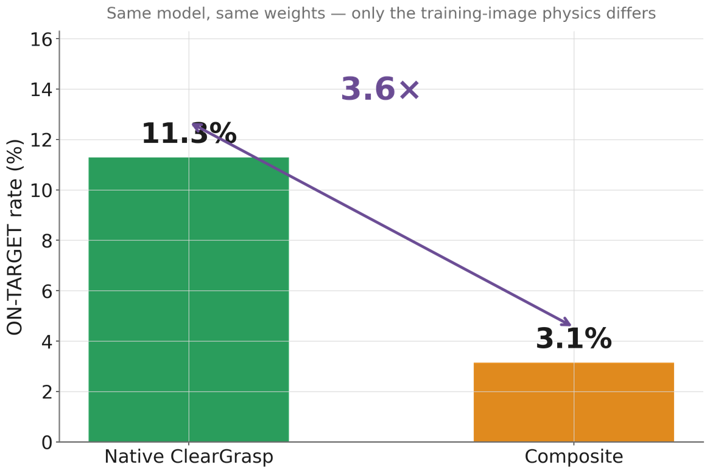
Fauget I 09
THE FINDING: NATIVE VS COMPOSITE

Slide 23
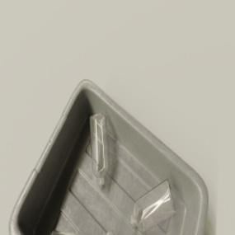
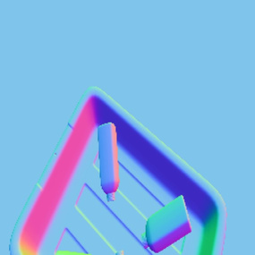
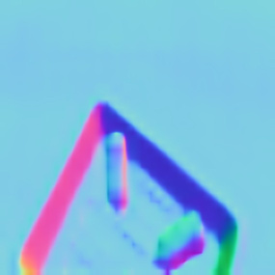
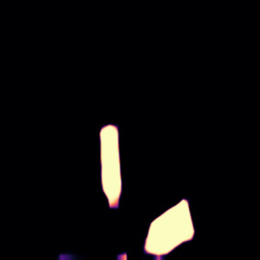
Fauget I 07
PERCEPTION RESULTS
Surface Normal Error Distribution
Threshold-Accuracy Curve
Input RGB
GT Normals
square-plastic-bottle-train
1.0
0.04
0.8
0.03
0.6
Density
Cumulative Proportion
Pred Normals
Pred Mask
0.02
0.4
0.01
0.2
square-plastic-bottle 11.25°
22.5°
0.00
0.0
0
10
20
30
40
50
60
70
80
90
0
10
20
30
40
50
60
Angular Error (degrees)
Angular Error (degrees)

Slide 24
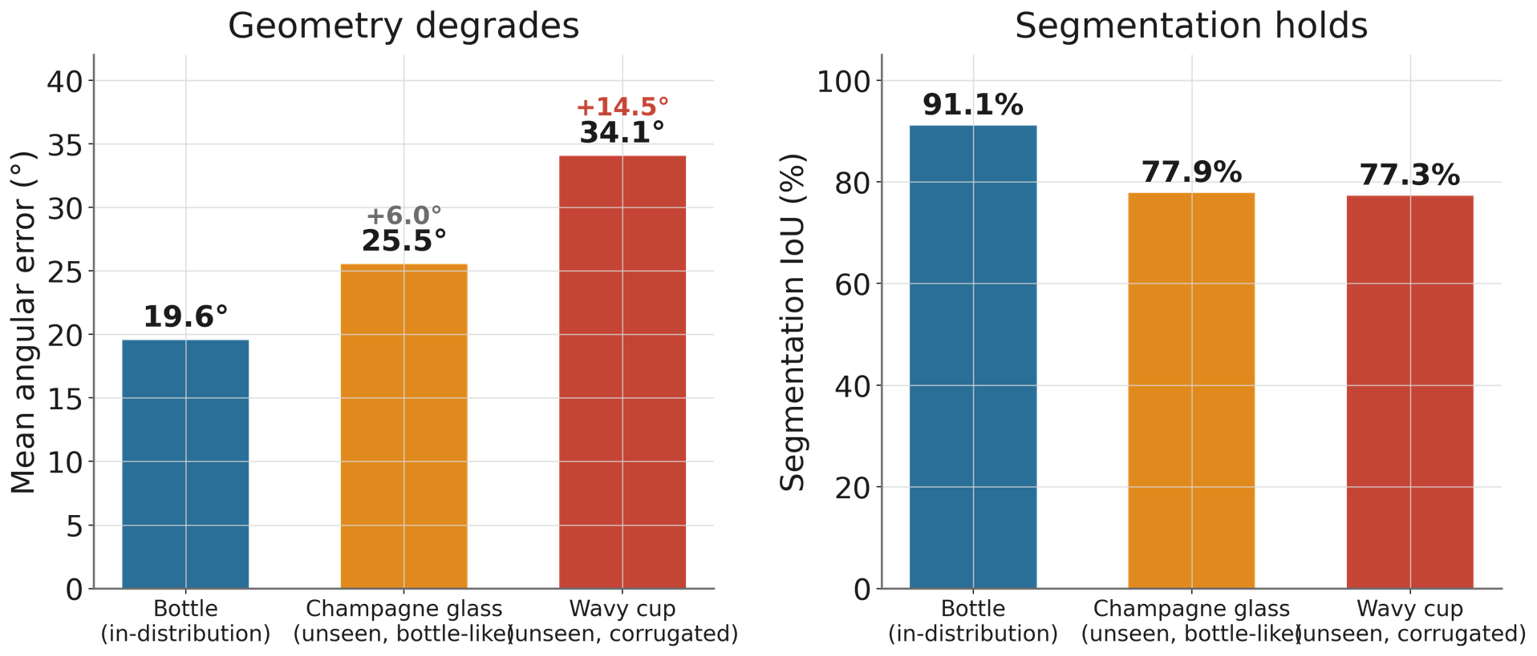
Fauget I 07
PERCEPTION RESULTS

Slide 25
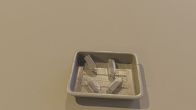





Fauget I 09
DEPTH ABLATION
RGB Input
GT Depth
Corrupted (Sensor)
Inpainted (cv2)
Poisson
(GT Normals)
Poisson (Predicted)
Depth Reconstruction Error
Depth Recovery Comparison
1.2 1.0 0.8
1.5
0.9297m
1.0
Mean RMSE (metres)
RMSE (metres)
0.6 0.4 0.2 0.0
0.5
0.4160m
0.1227m
0.1364m
0.0
Raw Corrupted
cv2.inpaint Baseline
Poisson
(GT Normals)
Poisson (Predicted)
Raw Corrupted
cv2.inpaint Baseline
Poisson
(GT Normals)
Poisson (Predicted)

Slide 26
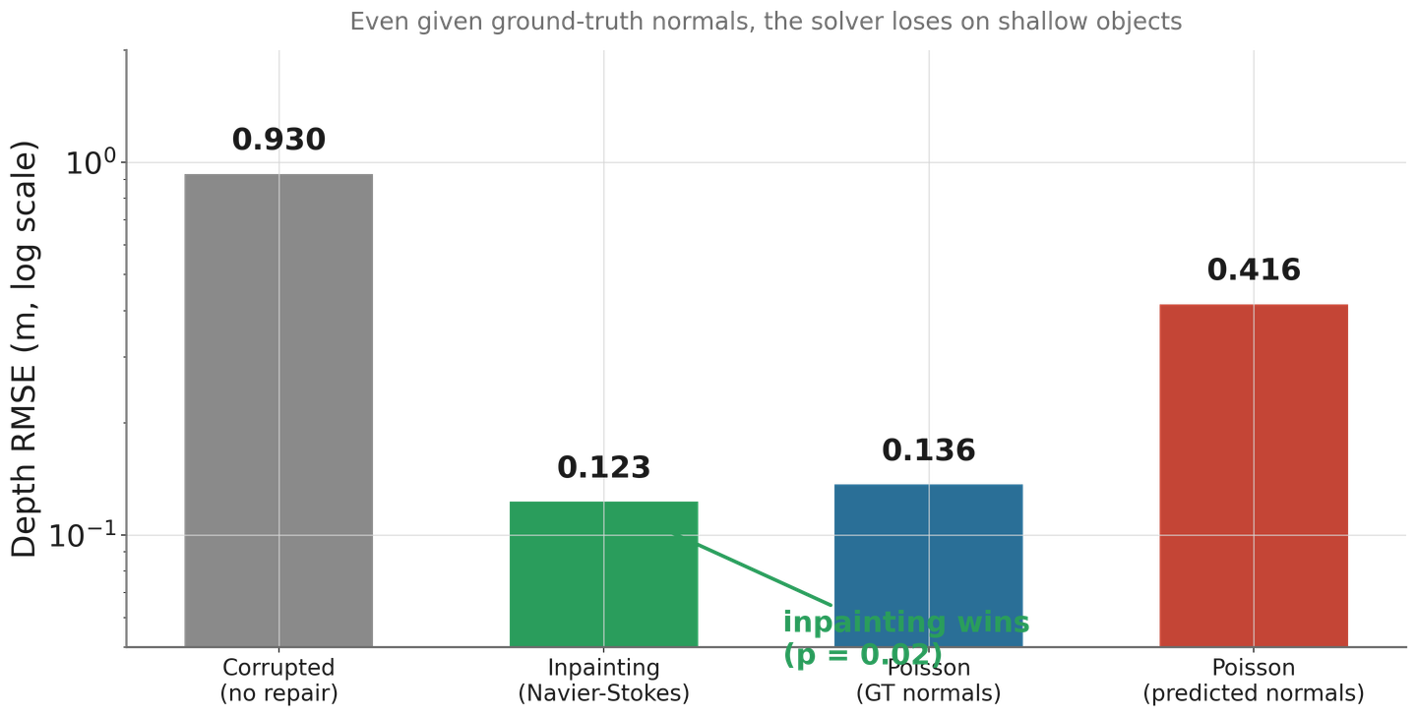
Fauget I 09
DEPTH ABLATION

Slide 27
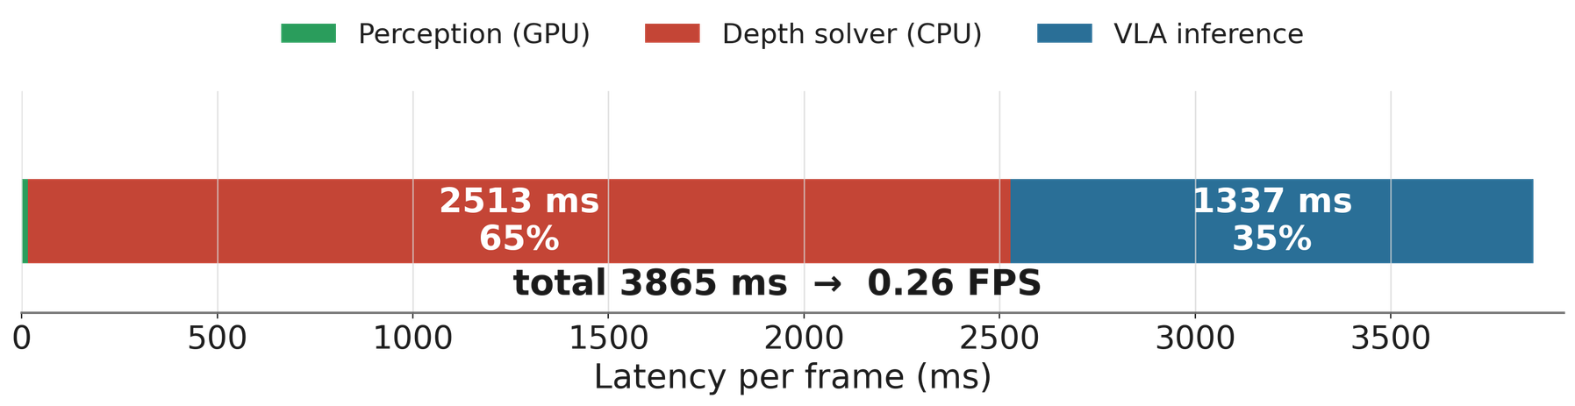
Fauget I 06
LATENCY : VLA FINE TUNING

Slide 28
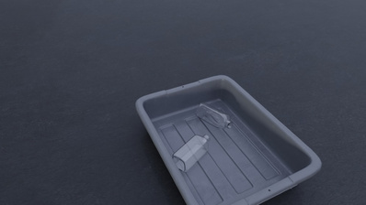
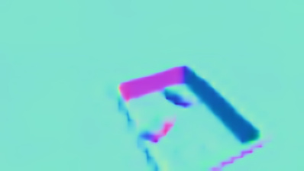
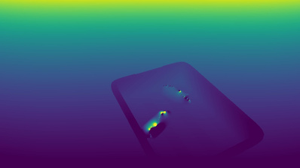

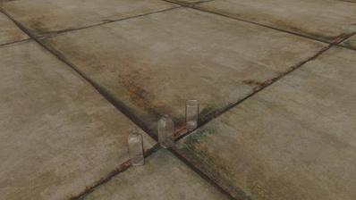
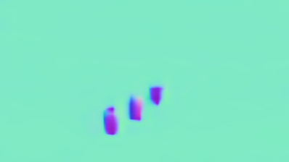
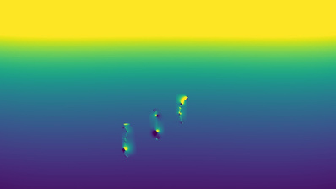

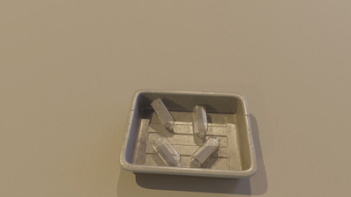
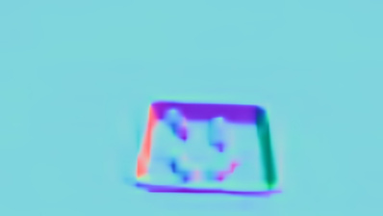
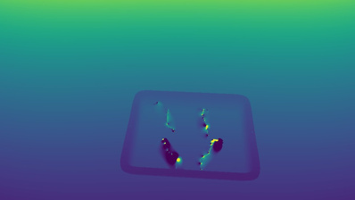

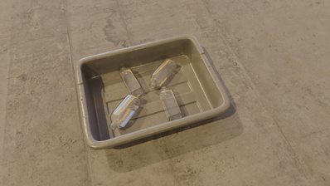
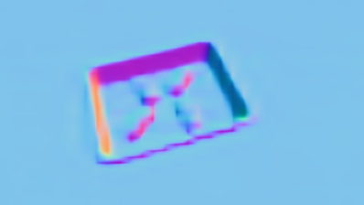
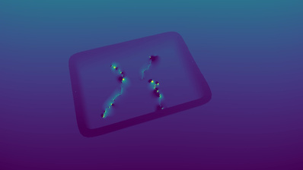
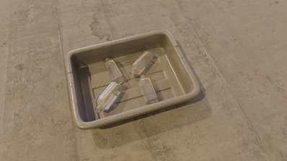
Fauget I 04
END-TO-END GALLERY
RGB Input
Predicted Normals
Reconstructed Depth
VLA Grasp Target
Notes:
The camera feeds two parallel paths. The RGB image goes to a
perception network that predicts surface normals and a segmentation
mask — essentially, where is the transparent object and what shape
is its surface. Those predictions feed a depth solver that fills
in the missing depth measurements.
Simultaneously, the same RGB image goes to OpenVLA — a 7-billion
parameter model fine-tuned with LoRA — which reads a language
instruction and outputs a 2D grasp target as discrete tokens.
The coordinate bridge combines the 2D target with the repaired
depth to get a 3D position in millimetres.
Everything in green is conceptual — I didn't have robot access.
The evaluation is on the blue and orange paths.

Slide 29
SYNTHESIS

Slide 30
Fauget I 02
FUTURE WORK
→ Physically-based rendering / real captures (attack the compositing bottleneck head-on)
→ Multi-category, instruction-conditioned training (test the semantic-flexibility promise)
→ Simulation validation: Gazebo + vLab (ABB IRB 360 delta; also 6-DOF arms) → GPU / learned depth completion (remove the 65% latency)
→ Physical validation on real hardware
→ Spatially-targeted supervision (RoboPoint-style pointing) if precision plateaus
Notes:
Less than 10% of plastic is recycled. Robotic sorting could help,
but it has a blind spot. These are transparent PET bottles — the
single most common recyclable plastic. On the left, what the camera
sees. On the right, what the depth sensor sees. Black means zero —
the sensor returns nothing. The structured infrared light refracts
straight through the plastic. The robot doesn't know the object
exists in 3D space.
[Pause ]
"Every robotic manipulation pipeline I know of assumes functioning
depth. So how do you grasp something the sensor can't see?"

Slide 31
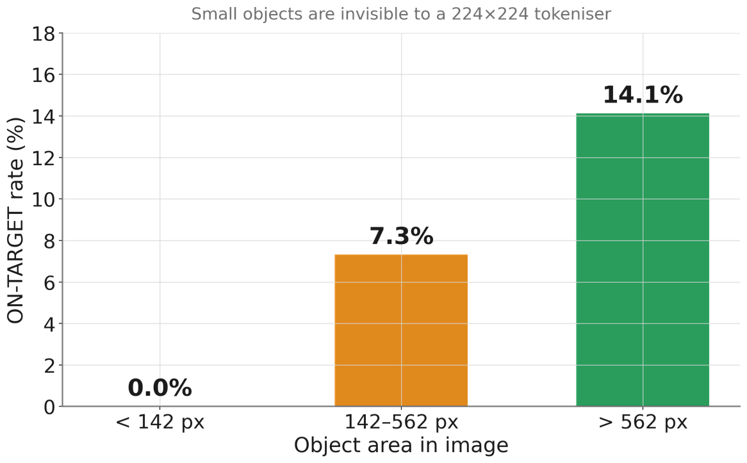
Fauget I 02
FUTURE WORK
From www.boschrexroth.com
Notes:
Less than 10% of plastic is recycled. Robotic sorting could help,
but it has a blind spot. These are transparent PET bottles — the
single most common recyclable plastic. On the left, what the camera
sees. On the right, what the depth sensor sees. Black means zero —
the sensor returns nothing. The structured infrared light refracts
straight through the plastic. The robot doesn't know the object
exists in 3D space.
[Pause ]
"Every robotic manipulation pipeline I know of assumes functioning
depth. So how do you grasp something the sensor can't see?"

Slide 32
Fauget I 10
THANK YOU

